Slide 1
CS 2001 Data Structures
Recursion and BackTracking

Slide 2
Agenda
What is Recursion ?
Why is Recursion Important ? What are the resource requirements for recursion?
An Example program with function calls and recursion implementation? How are recursive functions different from normal non-recursive functions?
Stack Frame? Activation Records? Dynamic Link?
Anatomy of a Recursive Call,

Slide 3
What is recursion?
When a function calls itself to make the problem smaller.
A Base Case
Terminate all recursive calls
Clearly identifiable
A Recurrence
Progression

Slide 4
When should we use recursion?
Recursion is made for solving problems that can be broken down into smaller, repetitive problems. It is especially good for working on things that have many possible branches and are too complex for an iterative approach. One good example of this would be searching through a file system.

Slide 5
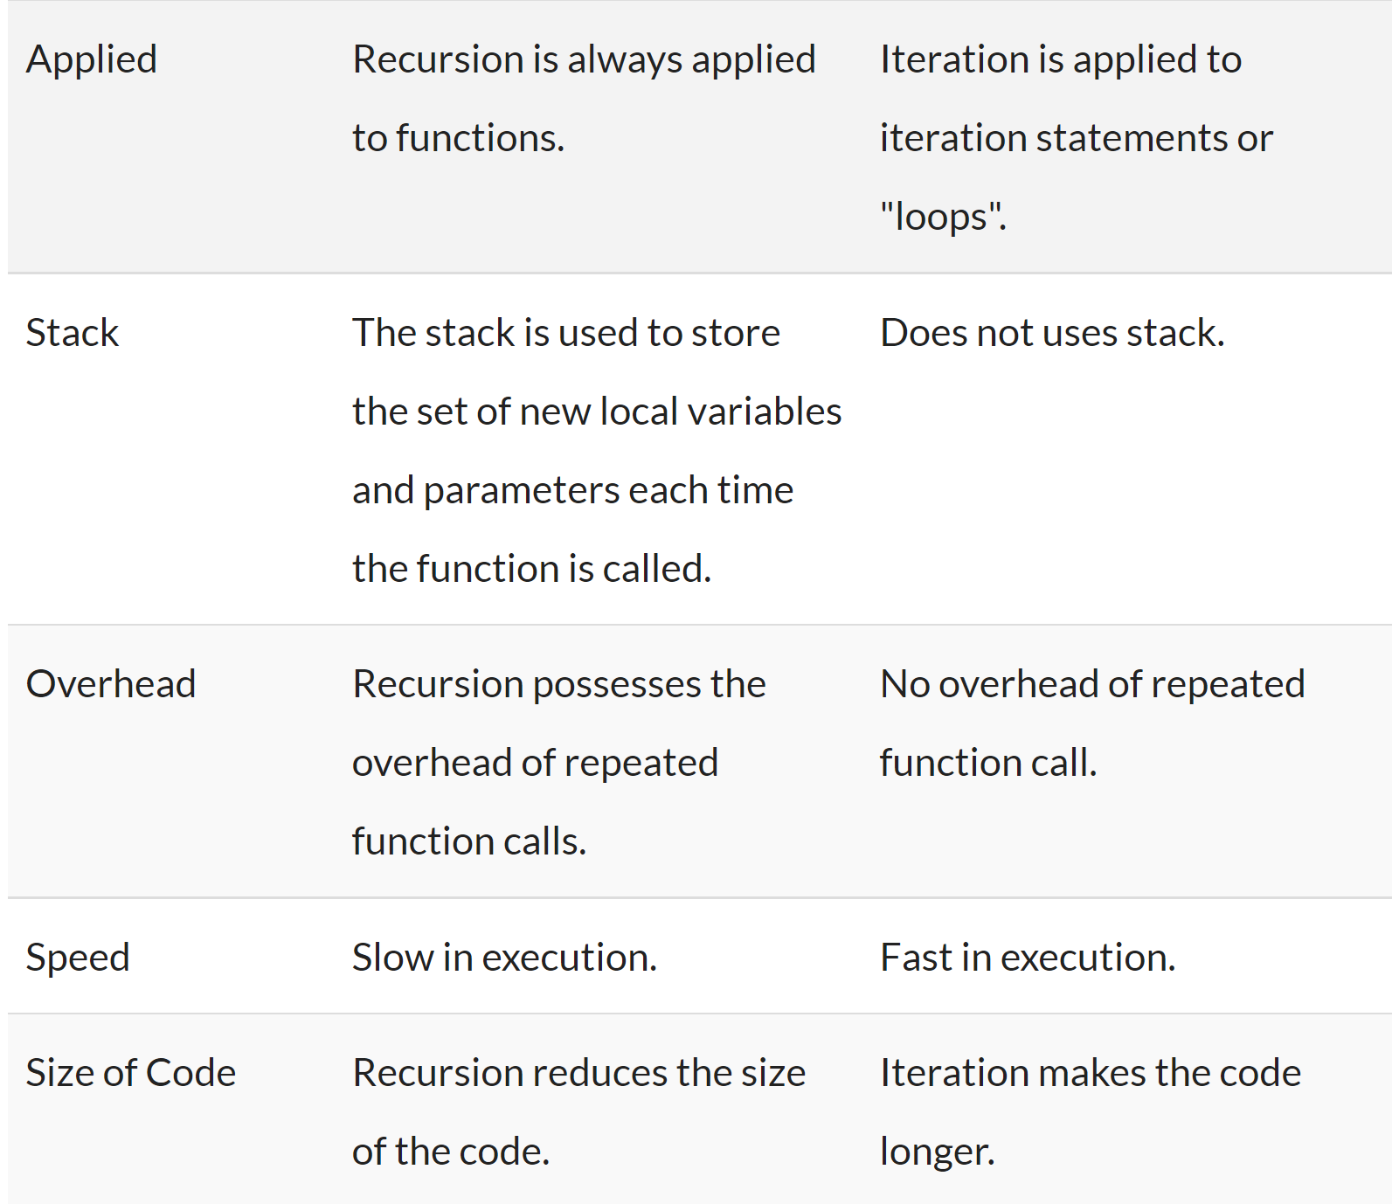
How are recursive functions different from normal non-recursive functions?

Slide 6
Working of recursion
Stack frame – our activation record
keeps the information about local variables, formal parameters, return address and all information passed to the caller function.

Slide 7
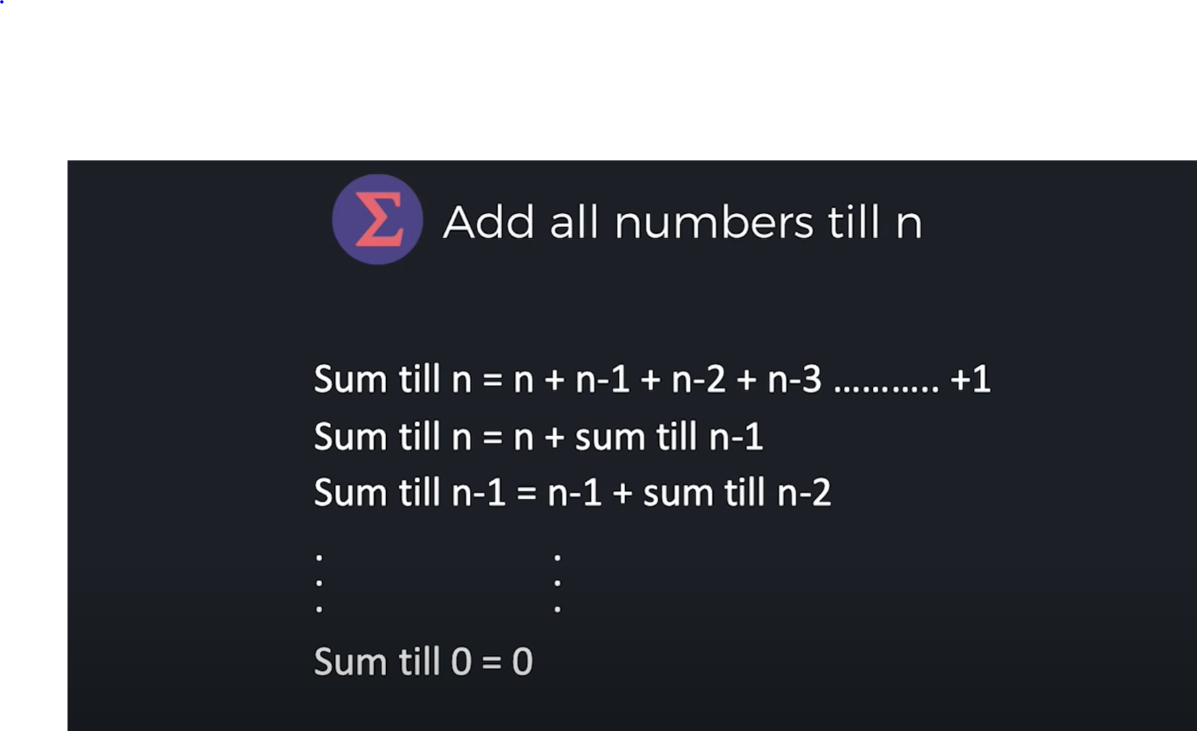
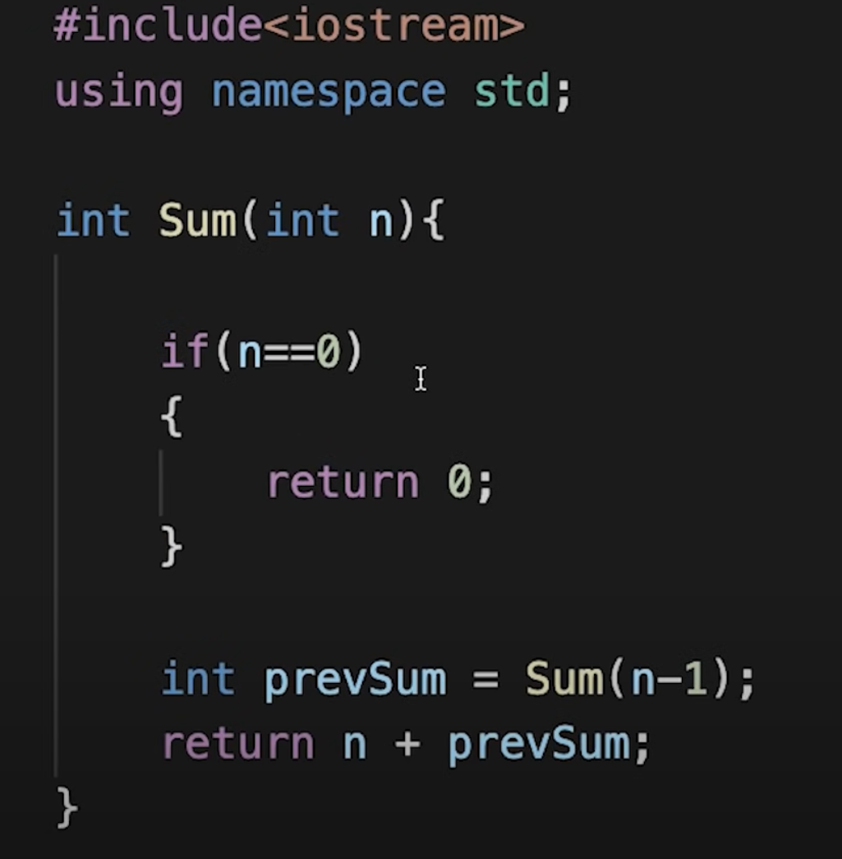

Slide 8
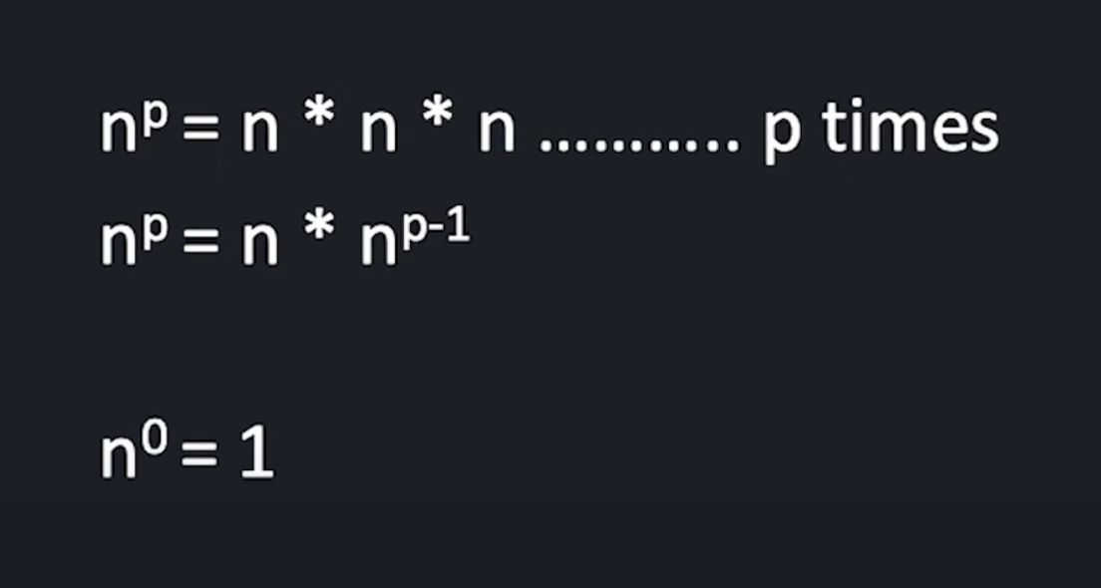
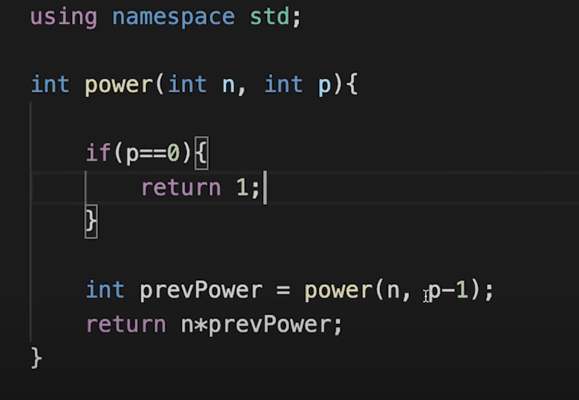
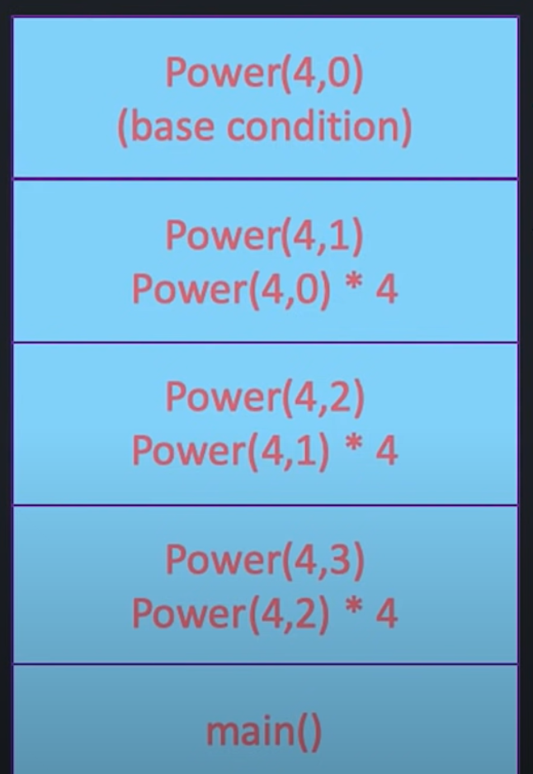
Calculate n raised to the power p.

Slide 9
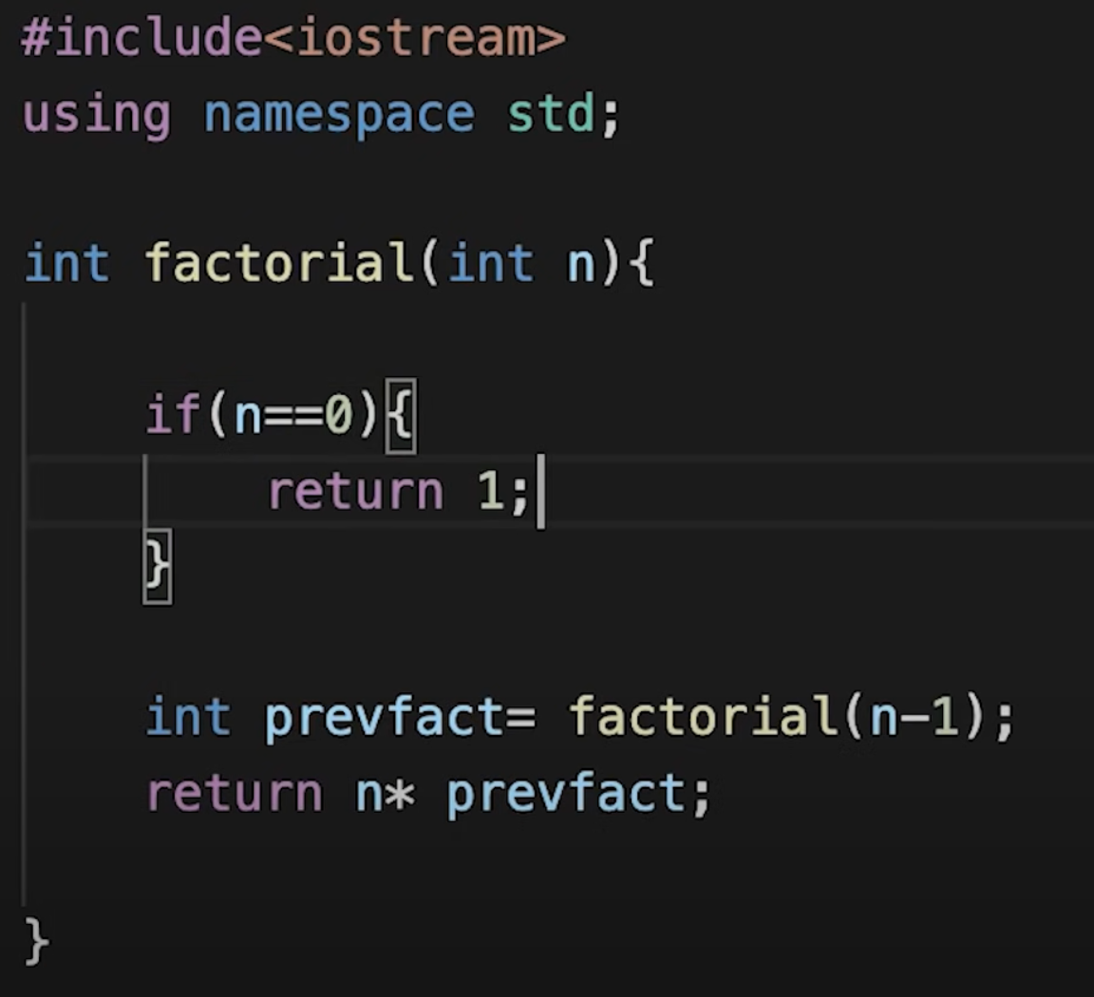
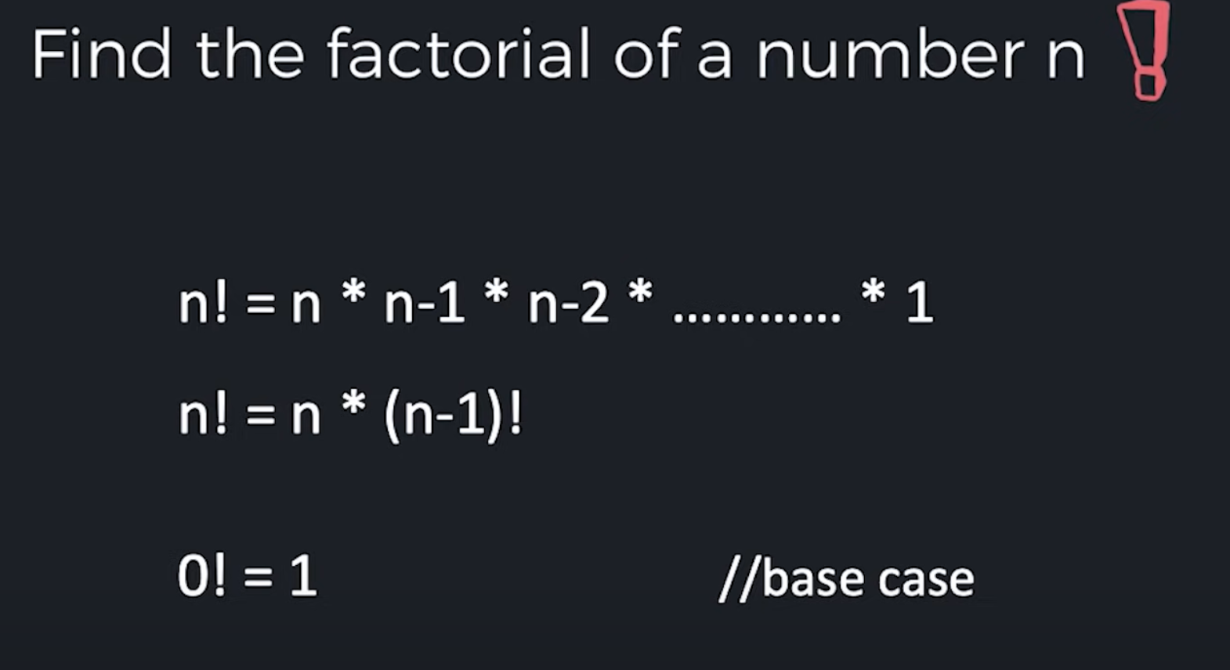

Slide 10
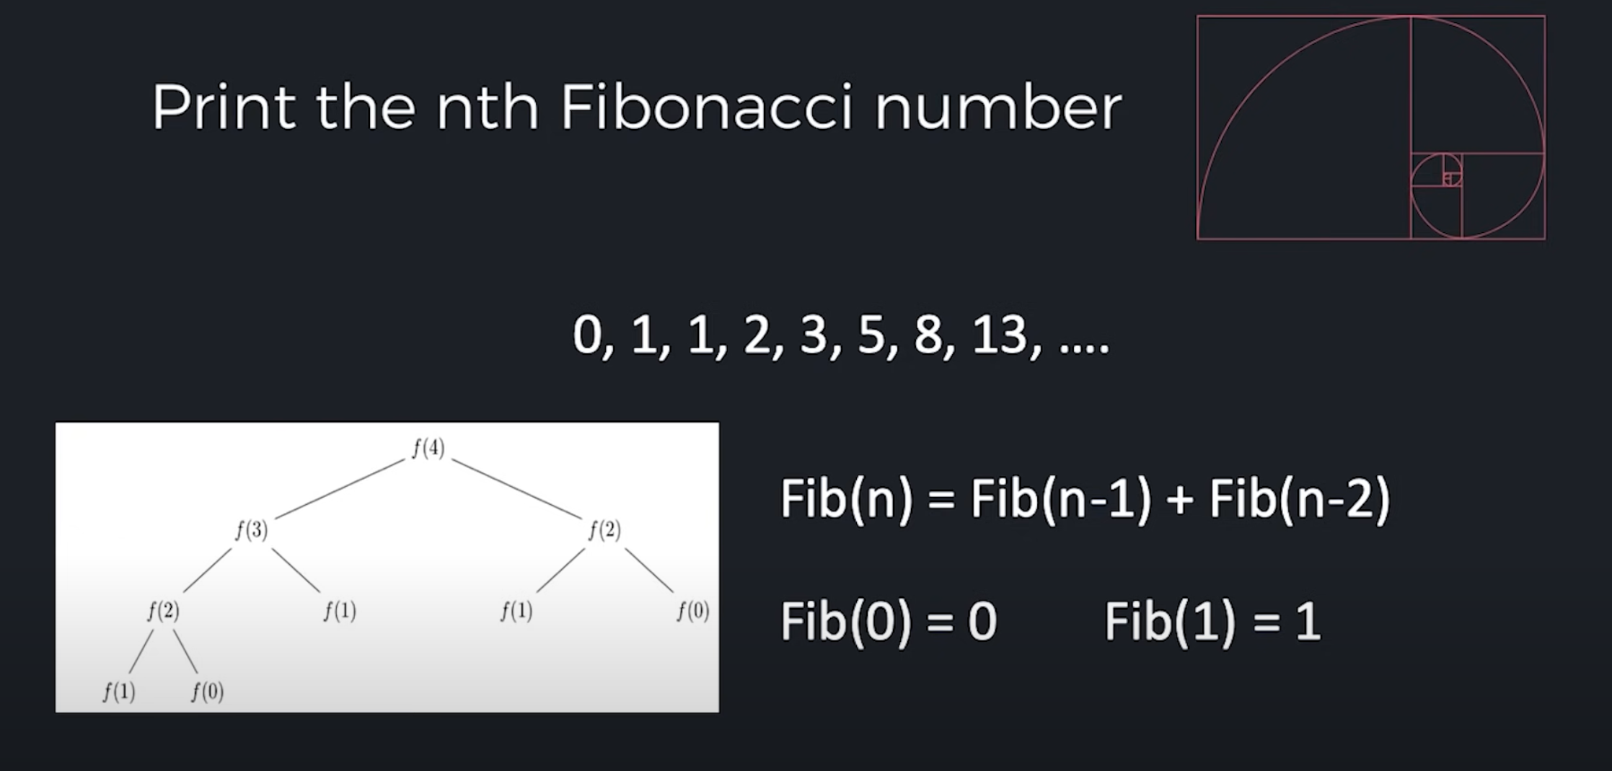
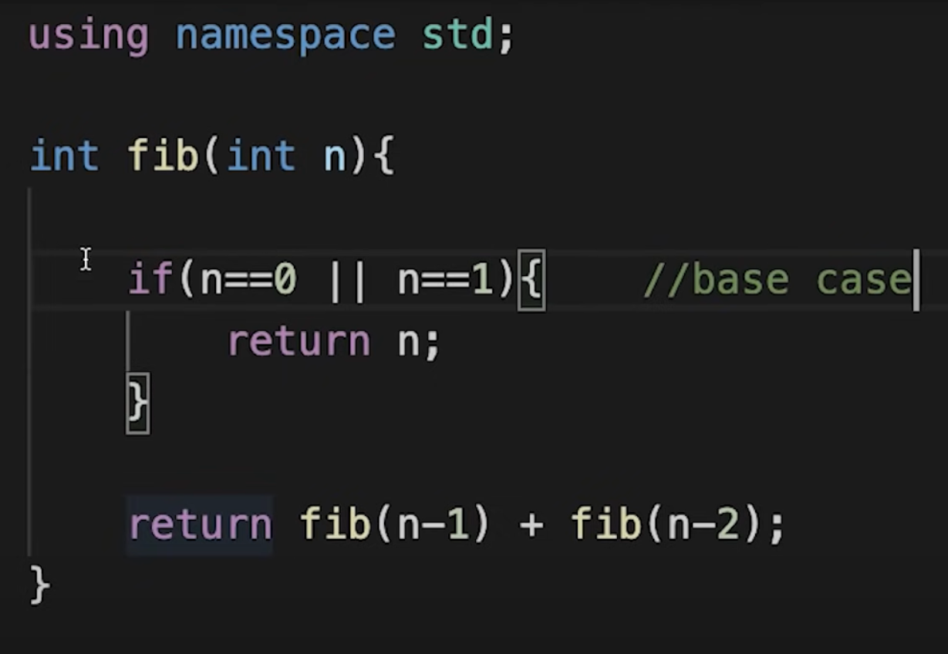

Slide 11
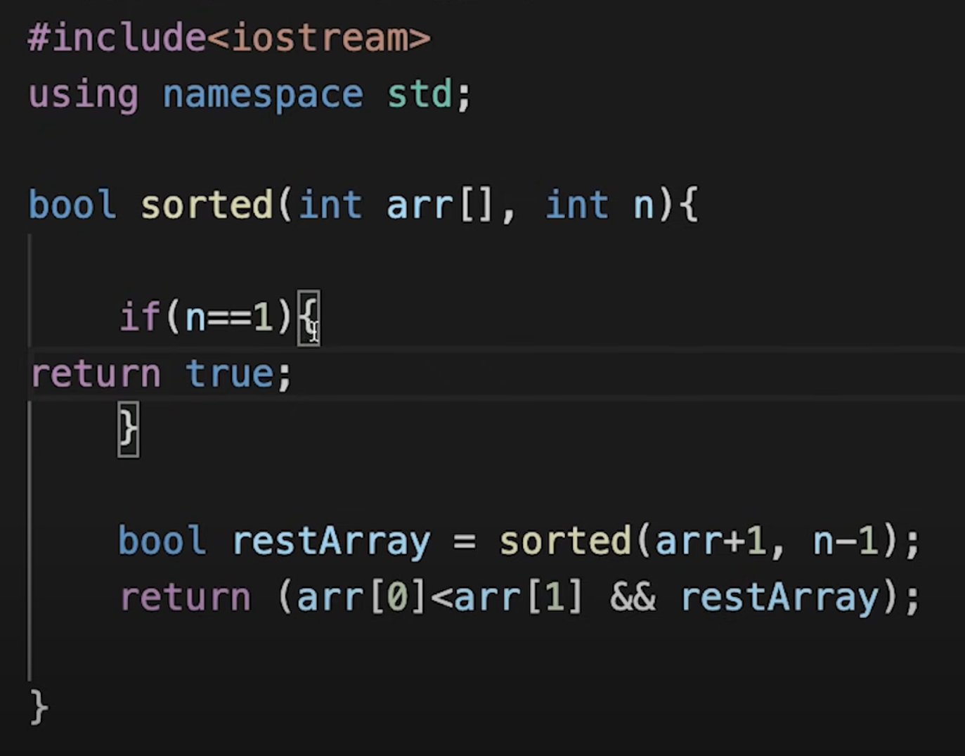
Given array is sorted or not

Slide 12
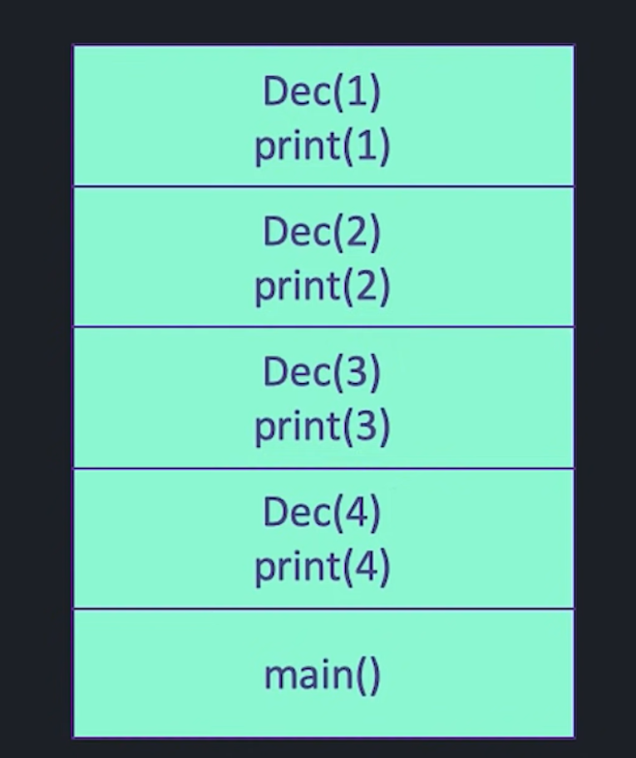
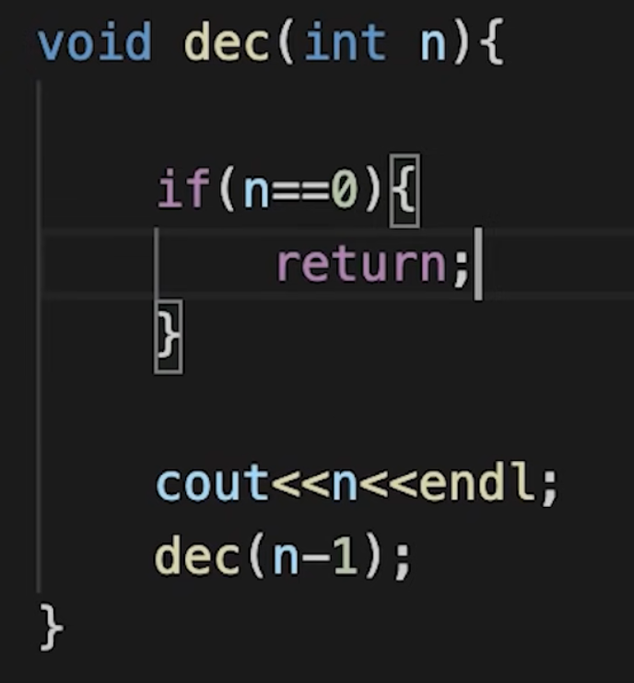
Print numbers till n..
Decreasing order

Slide 13
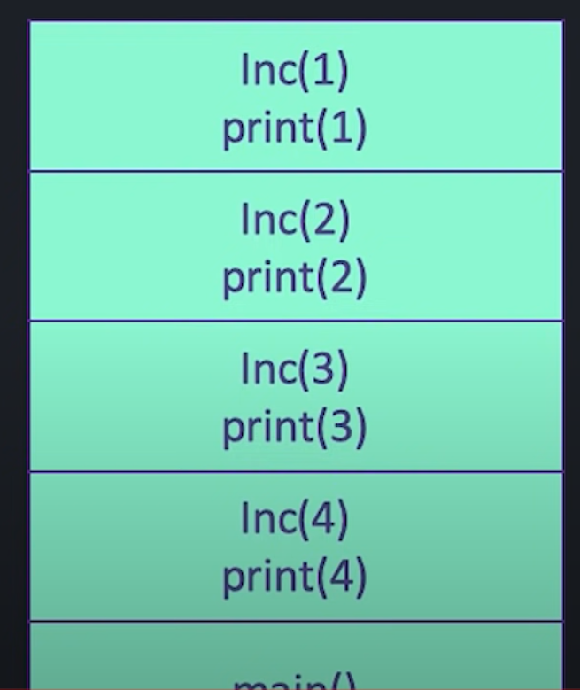
Increasing order

Slide 14
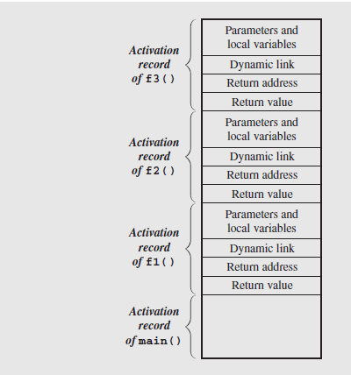
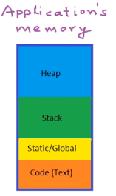
Stack Frame View
Contents of the run-time stack when main() calls function f1(), f1()
calls f2(), and
f2() calls f3().
Notes:
Because the stack may contain more than just frames (e.g., function return values or registers saved across calls), it is common to save the caller’s frame pointer as part of the callee’s control information. Each frame points to its caller’s frame on the stack. This pointer is called a dynamic link because it links a frame to its dynamic (runtime) predecessor.

Slide 15
Stack Frames are an implementation of Activation Records. The dynamic link tells you which activation record to return to when the current function is finished.

Slide 16
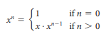
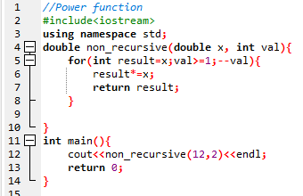
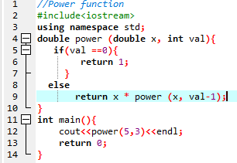
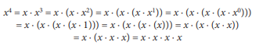
Recursive Function
A power function is defined in term of recursive definition and non recursive.

Slide 17
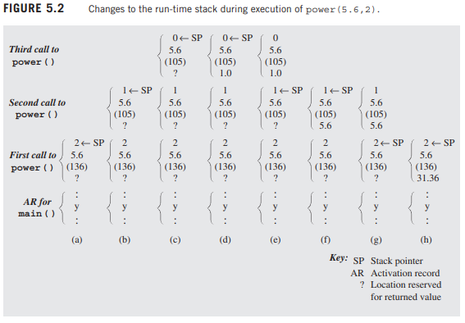
Stack frame in-depth view

Slide 18
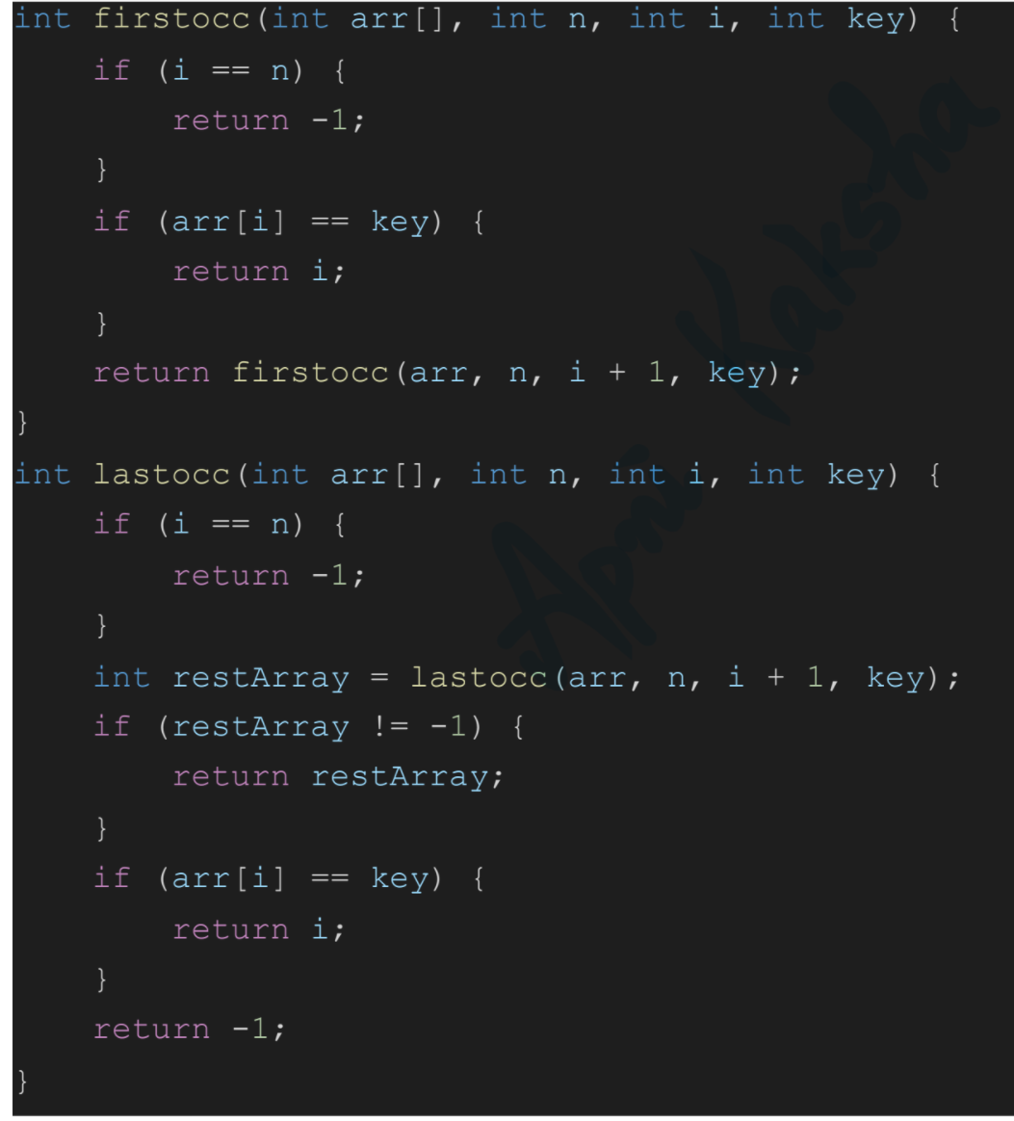
Find the first and last occurrence of an element using recursion

Slide 19
Classification of Recursion
Tail vs. Non-Tail
Direct vs. Indirect
Simple vs. Excessive
Nested Recursion

Slide 20
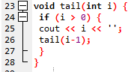
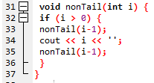
Tail Recursion
Tail Recursion is characterized by the use of only one recursive call at the very end of a function implementation.
This means when a recursive call is invoked there is no work left for the previous call.
Moreover, there is no pending recursive calls, either direct or indirect.

Slide 21
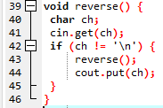
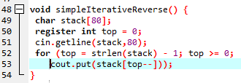
Non tail recursion example
Non-Tail recursion is characterized by the fact that there is still some work left for the first call and a recursive selfcall is invoked.

Slide 22
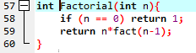
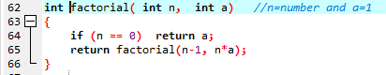
Tail vs Non Tail Recursion

Slide 23
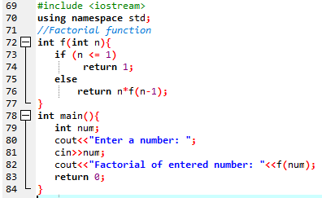
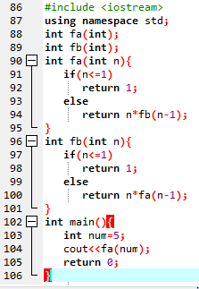
Direct Recursion vs Indirect Recursion
Direct recursion: When function calls itself, it is called direct recursion.
Indirect recursion: When function calls another function and that function calls the calling function, then this is called indirect recursion. For example: function A calls function B and Function B calls function A.

Slide 24
Nested Recursion
When a recursive function call is embedded into a recursive function, it is called “Nested Recursion”
Example of nested recursion is Ackerman function:
A(m,n) = n + 1 if m == 0
A(m,n) = A(m-1, 1) if m > 0 && n == 0
A(m,n) = A(m-1, A(m, n-1)) if m > 0 && n > 0
It is interesting for computational reasons due to the depth of recursion and due to the nested recursion.
For example, A(4, 2) is an integer of 19,729 decimal digits

Slide 25
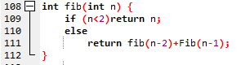
Excessive Recursion
Some recursive methods repeats the computations for some parameters, which results in long computation time even for simple cases.
This can be implemented in c++ as follows:

Slide 26
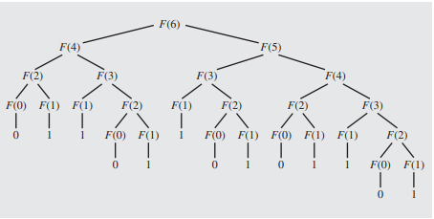
Excessive Recursion
To show how much this formula is inefficient, let us try to see how Fib(6) is evaluated.

Slide 27
Excessive Recursion: Example
For calculating fib(6), the method is called 25 times.
The same calculation are repeated again and again because the system forgets what have been already calculated.
The method is called 2*fib(n+1)-1 times to compute fib(n)
3,000,000 calls are needed to calculate the 31st element.

Slide 28
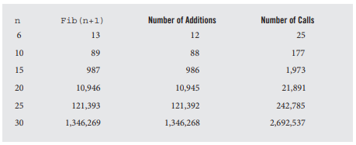
Comparison:
Number of addition operations and number of recursive calls to calculate Fibonacci numbers.

Slide 29
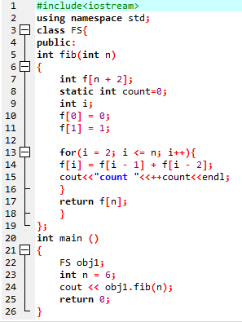
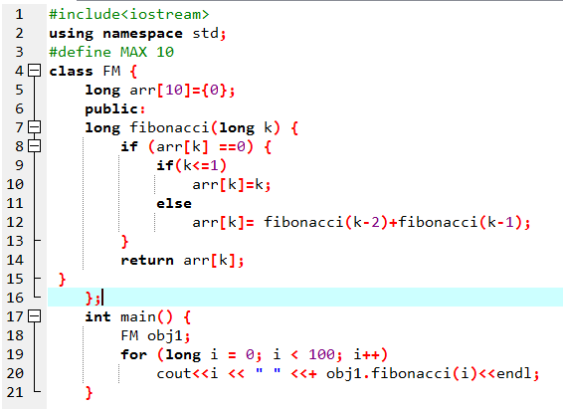
Memoizable Fibonacci recursive:

Slide 30
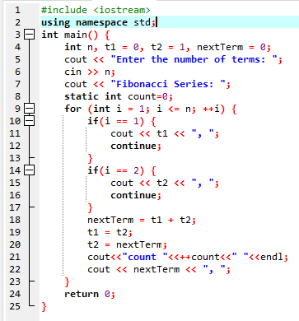
Iterative Method:

Slide 31
Conclusion
Recursion is a programming tool. Like any other topic in data structures, it should be used with good judgment.
Recursive solutions are simplified one for understanding, short and precise code, readability and maintainability are increases.
Sometimes, slow and hard on resources. Specifically available on only compilers that support recursion.
Sometimes recursion is faster than iterative approach. Running a simple routine implemented recursively and iteratively and comparing the two run times can help to decide if recursion is advisable.

Slide 32
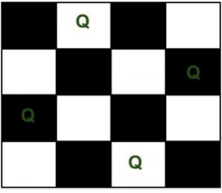
N-Queen Problem
We have N queens and N x N chess board. The objective of this problem is such that we need to place all N queens on N x N chess board in such a manner that no two queens in under attack to each other.
Legal move attacking means no 2 queens in same row, col, and diagonal
Two queens will be under attack if one of the following conditions is true:-
firstly, if they are in the same row.
secondly, if they are in the same column.
finally, if they are in the same diagonal.

Slide 33
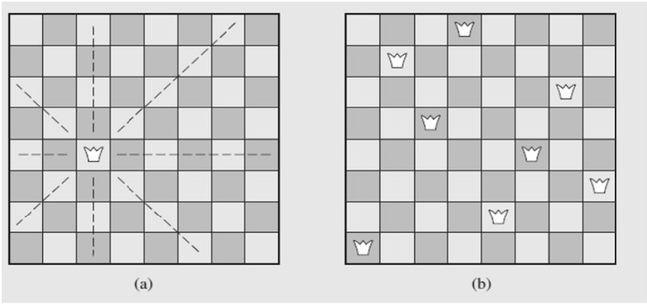
N-Queen Problem
Idea of the size of the problem:
There are 4,426,165,368 ways to arrange 8 queens on a chessboard of 64 squares.
No queen can reside in a row or a column that contains another queen
only 40,320 (8!) arrangements of queens to be checked for attacks along diagonals

Slide 34
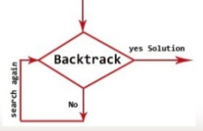
Back Tracking
Backtracking is an algorithmic technique for solving problems recursively by trying to build a solution incrementally, one piece at a time, removing those solutions that fail to satisfy the constraints of the problem at any point of time.

Slide 35
Backtracking Algorithm
The idea is to place queens one by one in different columns, starting from the leftmost column. When we place a queen in a column, we check for clashes with already placed queens.
In the current column, if we find a row for which there is no clash, we mark this row and column as part of the solution. If we do not find such a row due to clashes then we backtrack and return false.

Slide 36
Backtracking Algorithm
Start in the leftmost column
If all queens are placed
return true
Try all rows in the current column. Do following for every tried row.
If the queen can be placed safely in this row then mark this [row, column] as part of the solution and recursively check if placing queen here leads to a solution.
If placing the queen in [row, column] leads to a solution then return true.
If placing queen doesn't lead to a solution then unmark this [row, column] (Backtrack) and go to step (a) to try other rows.
If all rows have been tried and nothing worked, return false to trigger backtracking.

Slide 37
Example to understand Backtracking

Slide 38
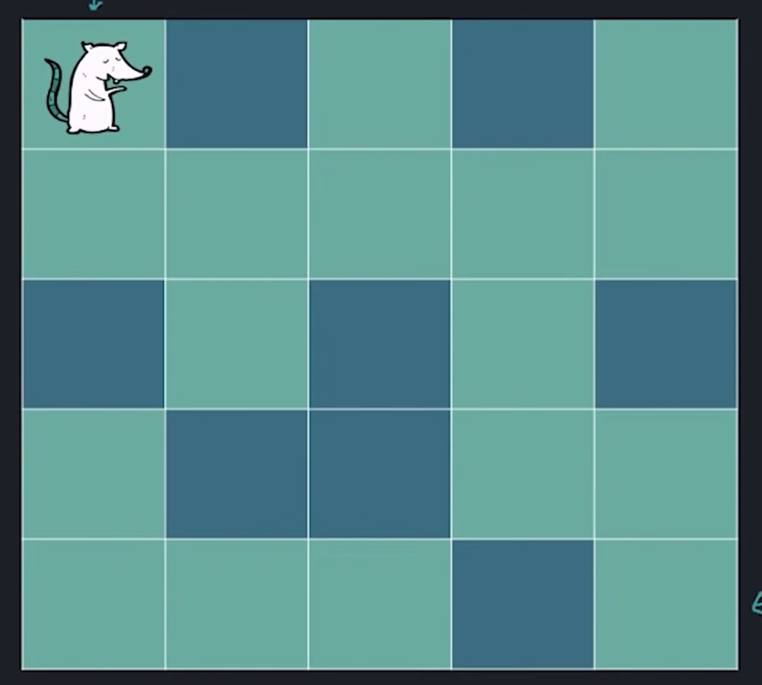
Rat in a maze

Slide 39
Input:
0 denotes wall, 1 denotes free path
two numbers n, m
Next n lines contain m numbers (0 or 1)
Output:
Print 1 if rat can reach (n-1,m-1)
Print 0 if it can not reach (n-1,m-1)
Test Case 1:
Input:
5 5
1 0 1 0 1
1 1 1 1 1
0 1 0 1 0
1 0 0 1 1
1 1 1 0 1
Output:
1

Slide 40
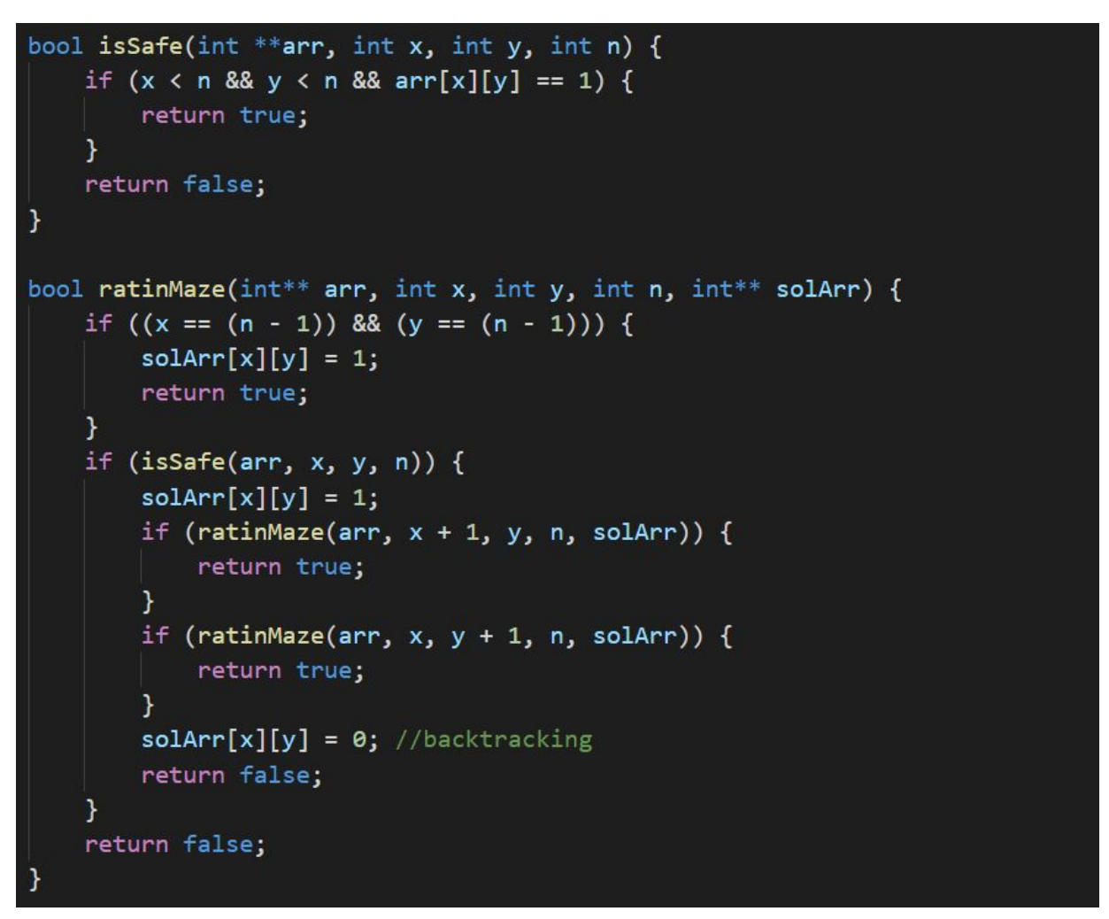

Slide 41
N-Queen Problem
We have N queens and N x N chess board. The objective of this problem is such that we need to place all N queens on N x N chess board in such a manner that no two queens in under attack to each other.
Legal move attacking means no 2 queens in same row, col, and diagonal
Two queens will be under attack if one of the following conditions is true:-
firstly, if they are in the same row.
secondly, if they are in the same column.
finally, if they are in the same diagonal.

Slide 42
N-Queen Problem
Idea of the size of the problem:
There are 4,426,165,368 ways to arrange 8 queens on a chessboard of 64 squares.
No queen can reside in a row or a column that contains another queen
only 40,320 (8!) arrangements of queens to be checked for attacks along diagonals

Slide 43
Back Tracking
Backtracking is an algorithmic technique for solving problems recursively by trying to build a solution incrementally, one piece at a time, removing those solutions that fail to satisfy the constraints of the problem at any point of time.

Slide 44
Backtracking Algorithm
The idea is to place queens one by one in different columns, starting from the leftmost column. When we place a queen in a column, we check for clashes with already placed queens.
In the current column, if we find a row for which there is no clash, we mark this row and column as part of the solution. If we do not find such a row due to clashes then we backtrack and return false.

Slide 45
Backtracking Algorithm
Start in the leftmost column
If all queens are placed
return true
Try all rows in the current column. Do following for every tried row.
If the queen can be placed safely in this row then mark this [row, column] as part of the solution and recursively check if placing queen here leads to a solution.
If placing the queen in [row, column] leads to a solution then return true.
If placing queen doesn't lead to a solution then unmark this [row, column] (Backtrack) and go to step (a) to try other rows.
If all rows have been tried and nothing worked, return false to trigger backtracking.

Slide 46
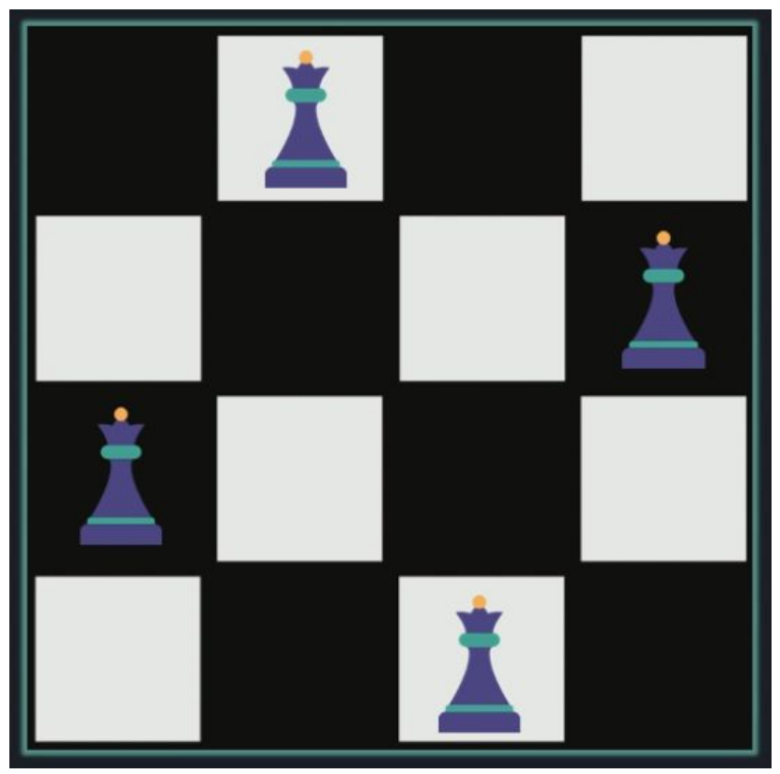

Slide 47
Input:
A single integer n
Output:
n x n matrix, where one denotes queen, and 0 for an empty cell.
Test Case 1:
Input:
4
Output:
0 1 0 0
0 0 0 1
1 0 0 0
0 0 1 0

Slide 48
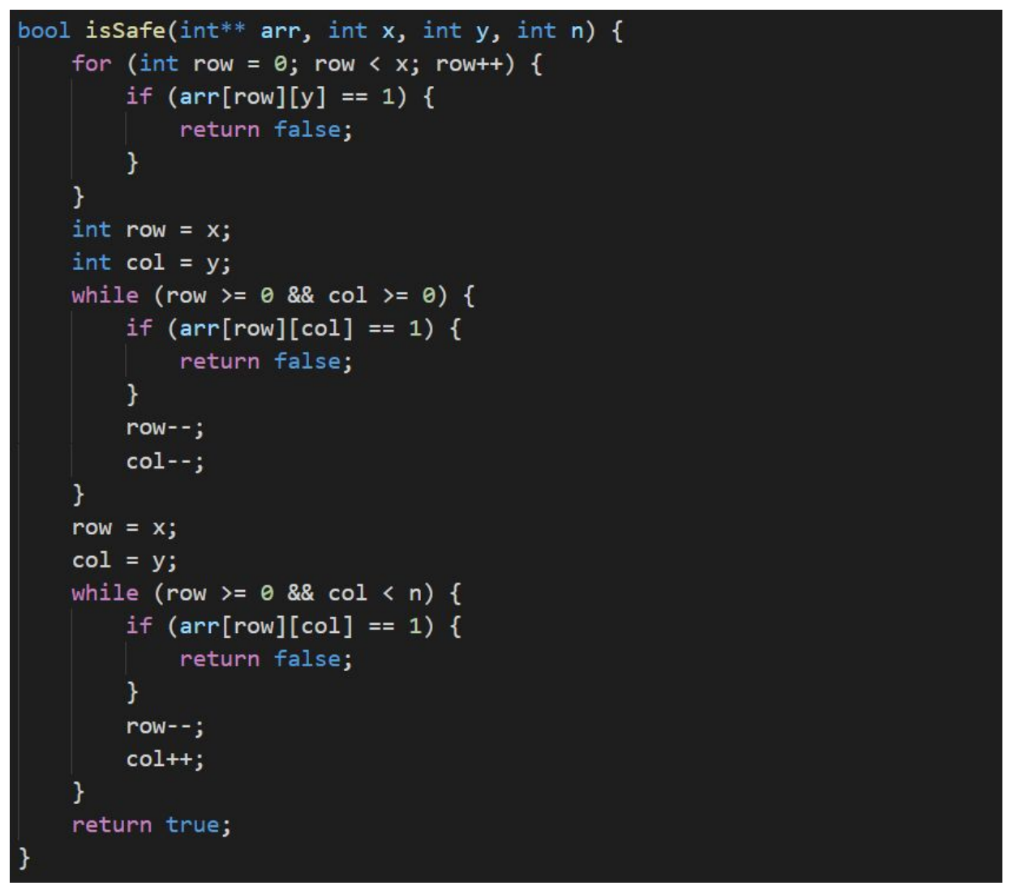

Slide 49
